Slide 1

Introduction to R
Chapter 8

Slide 2

Golden rule of R
”If it works, don't touch it!"

Slide 3
How/why people use R
Most people: specifically for performing statistical analysis
Us: use R as a “data programming language”
not limited in the types of analysis we can do
can explore hidden stories in data
We are not going to learn R in its entirety
focus on exploratory data analysis (EDA)

Slide 4
Some nice things about R
Can write sophisticated scripts, can also use more exploratory environments (RStudio, RMarkdown)
Some of the most user-friendly documentation
The language exists somewhere between Python and Mathematica

Slide 5
About EDA
Understanding data and its limitations through interactive investigation
Experiment within and experiment
A more robust analysis method, independent of software/technology*
*requires more justification
Can reveal unconventional patterns

Slide 6
Example
Create list of molecular interactions
Interactions automatically sourced from academic papers
Some interactions have more details than others
Phosphorylation – adding a phosphate group to a protein, usually activates/increases something

Slide 7
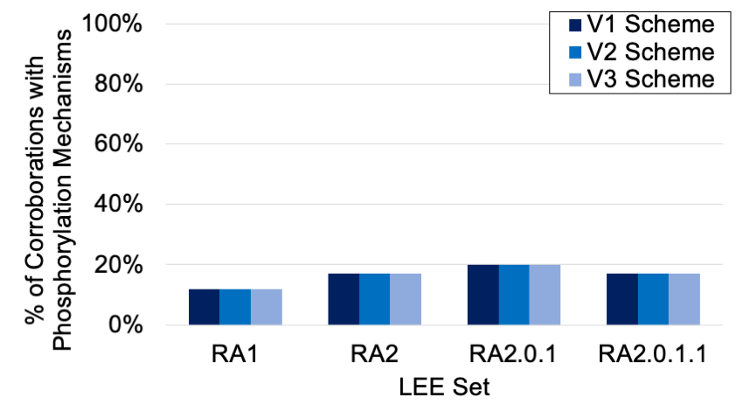
EDA results – what do we see?
RA1 – interactions collected through general search
RA2 – interactions collected through targeted search
RA2.0.1 – RA2 interactions filtered through bioinformatics tools to remove “junk” interactions
RA2.0.1.1 – RA2.0.1 interactions manually judged by expert to remove junk

Slide 8
Anatomy of R syntax
function argument
expression to evaluate
>log(e) [1] 1 >help(log) >
function
return value
help function

Slide 9
Function arguments
A value provided to obtain the return value
There are required and optional arguments
Plot function: plot(x, y, col.axis, xaxs, xlab, xlim, yaxs, ylab, ylim, main, pch, col, cex.lab, cex.axis, cex.main, cex.sub, cex,…)
Can also use variables as arguments

Slide 10
Programming variables
Much the same as algebra – placeholders
Main difference → in programming variables can be holders for unknown or known variables
Variables can themselves be variable
To assign variables in R, use <- operator
> e <- 2.718281828904590

Slide 11
Types of values* in R
Numeric (a.k.a. float)
1.4, 3.0, -5.001
Integer
1,2,3,…
Character (a.k.a. string)
“protein”, ”CGTAGCTTGACCT”
Logical (a.k.a. Boolean)
True and False
Complex and raw (not this course)
*value has multiple meanings in CS
Notes:
Value means a type of input or output.

Slide 12
Special values
NA ← represents missing data
NULL ← represents a ‘none’ value
“Nothing is zero but zero is not always nothing”
Inf, -Inf ← positive/negative infinity
NaN ← ”Not a Number”, things like 0/0
Yes, the capitalization matters
Notes:
Null means nothing

Slide 13
Boolean expressions
An expression that evaluates the truth of a statement
Often uses comparison operators
Returns Boolean values TRUE or FALSE
> 5+3 == 11 [1] FALSE > “hello” %in% c(“hello”,”goodbye”) [1] TRUE > 11-9 != 6 [1] TRUE
Notes:
Is hello in the set of hello and goodbye

Slide 14
Exercise
Try the following R commands and see what the result is: > is.nan(0/0) > is.nan(5/0) > 5/0 > is.nan(c()) > is.na(c()) > is.null(c())

Slide 15
Types of Data Structures
Scalar – singular data value (0-D)
Vector – a container of data (1-D)
Factor – vector that stores categorical values
List – a container of data (1-D)
Dataframe – a container of data (2-D)
Class – gives coding objects (variables, values, containers, etc.) higher-level properties
Notes:
Classes differentiate between levels

Slide 16
Vectors
Defined by function c()
Each value in a vector is called an element
> vect <- c(3.4, 5.0, 13.1)
Can also have “names” for each value (Python dictionary)
> vect <- c(a=3.4, b=5.0, c=13.1)
All values in a vector must be of the same type (all numeric, all character, all Boolean…)

Slide 17
Referencing vector elements
You can use names to reference the values > names(vect) [1] “a” ”b” “c” > vect[‘a’] a 3.4
Discussion: Why would naming values in a vector be useful?

Slide 18
Indexing vectors
index: the numbered location of a value (noun) to reference a value by location (verb)
> vect <- c(1, 1, 2, 3, 5, 8) > vect[3] [1] 2
indexing in R begins at 1, not at 0

Slide 19
Advanced indexing
> vect <- c(1,1,2,3,5,8,13) ← vector of length 7 > vect[3:5] ← return 3rd, 4th, and 5th elements > vect[c(2,1,10) ← out of range indexing – what will this return? > vect[c(-4,-5)] ← exclude 4th and 5th elements > vect[c(2,3,4,5,7,1,6)] ← reorder elements > vect[6:1] ← reverse elements

Slide 20
Exercise: what is a tacocat?
What is a palindrome?
How do you compare if two things are equal?
How do you find the reverse of a word?
Is “tacocat” a palindrome?
What if you didn’t know the length of the word?

Slide 21
One Solution:
> vect <- c(“t”,”a”,”c”,”o”,”c”,”a”,”t”) > vect == vect[length(vector):1] [1] TRUE TRUE TRUE TRUE TRUE TRUE TRUE
Using the length() function generalizes for any vector
Generalized code is usually more robust
Rule #4: There are exceptions to every rule

Slide 22
Indexing character values
Use substr() function
substr(char, start, stop)
> word <- “tacocat” > substr(word,1,1) [1] “t” > substr(word,1,4) [1] “taco”

Slide 23
Vectorization
Applying operations to vectors > vect_1 <- c(1,2,3,4) > vect_2 <- c(4,3,2,1)
What is vect_1 + vect_2?

Slide 24
Examples
c(1,2,3) + c(4,5,6)
c(1,2,3) + 2
c(1,2,3) + c(4,5)
Vector sequence 1:50
THINK-PAIR-SHARE: Where would you want to use each of these?

Slide 25
Coercion
Forcing vector elements into the same type
If you don’t tell R what to do, it’ll choose for you
You don’t want R to choose for you
Try making a heterogeneous vector (use multiple value types). What happens?

Slide 26
Lists
Lists are like vectors, but do not have to be homogeneous
Lists are in the data class, vectors are in value class
Define using the list() function > list1 <- list(”red”,42, FALSE)

Slide 27
Dataframes
TL;DR – how R represents spreadsheets
Can be imported from file or user defined
Can perform operations on large datasets at once

Slide 28
Example
Name | House | Score
Korra | Water | 7
Bolin | Earth | 9
Mako | Fire | 4
Asmai | Tech | 6
Tenzin | Air | 7
> Name <- c(“Korra”,”Bolin”,”Mako”,”Asami”,”Tenzin”)
> House <- c(“Water”,”Earth”,”Fire”,”Tech”,”Air”)
> Score <- c(7,9,4,6,7)
> df <- data.frame(Name,House,Score)
> print(df)

Slide 29
Indexing Dataframes
Referencing column > df[,1] > df$Name
Referencing row > df[2,]
Referencing cell > df[4,3]

